Slide 1
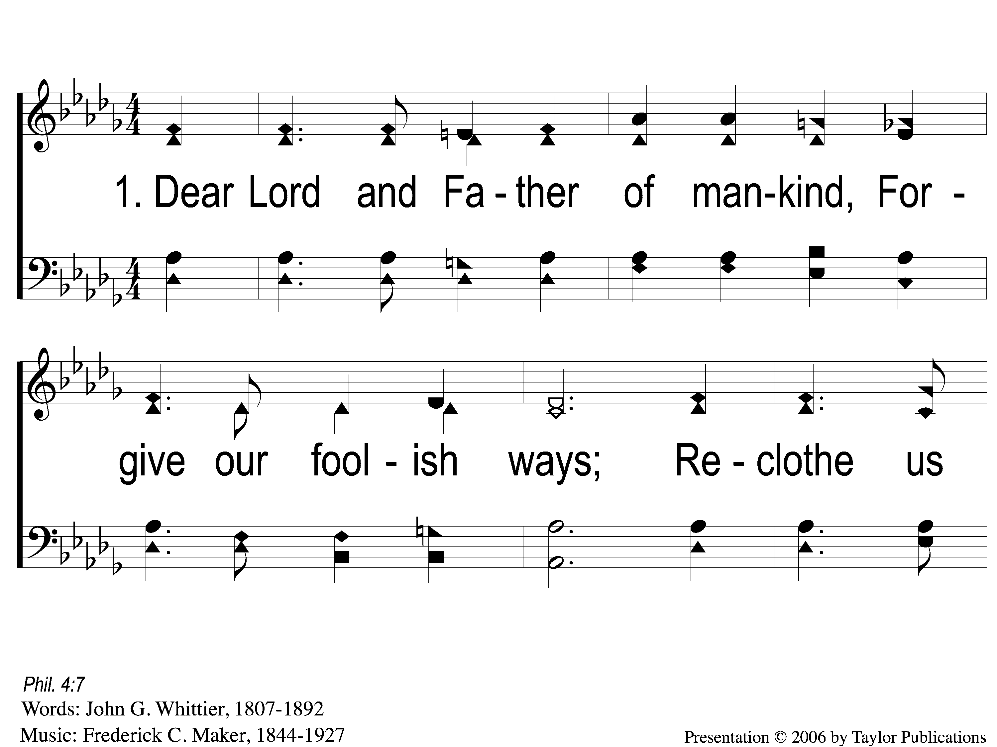
1-1 Dear Lord and Father of Mankind
Dear Lord and Father of Mankind
77

Slide 2
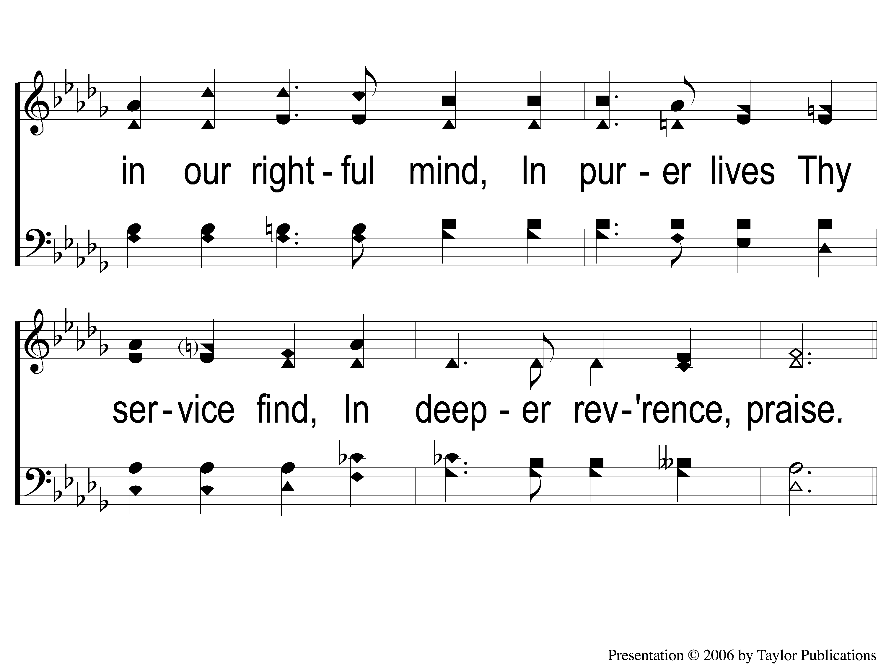
1-2 Dear Lord and Father of Mankind
Dear Lord and Father of Mankind
77

Slide 3
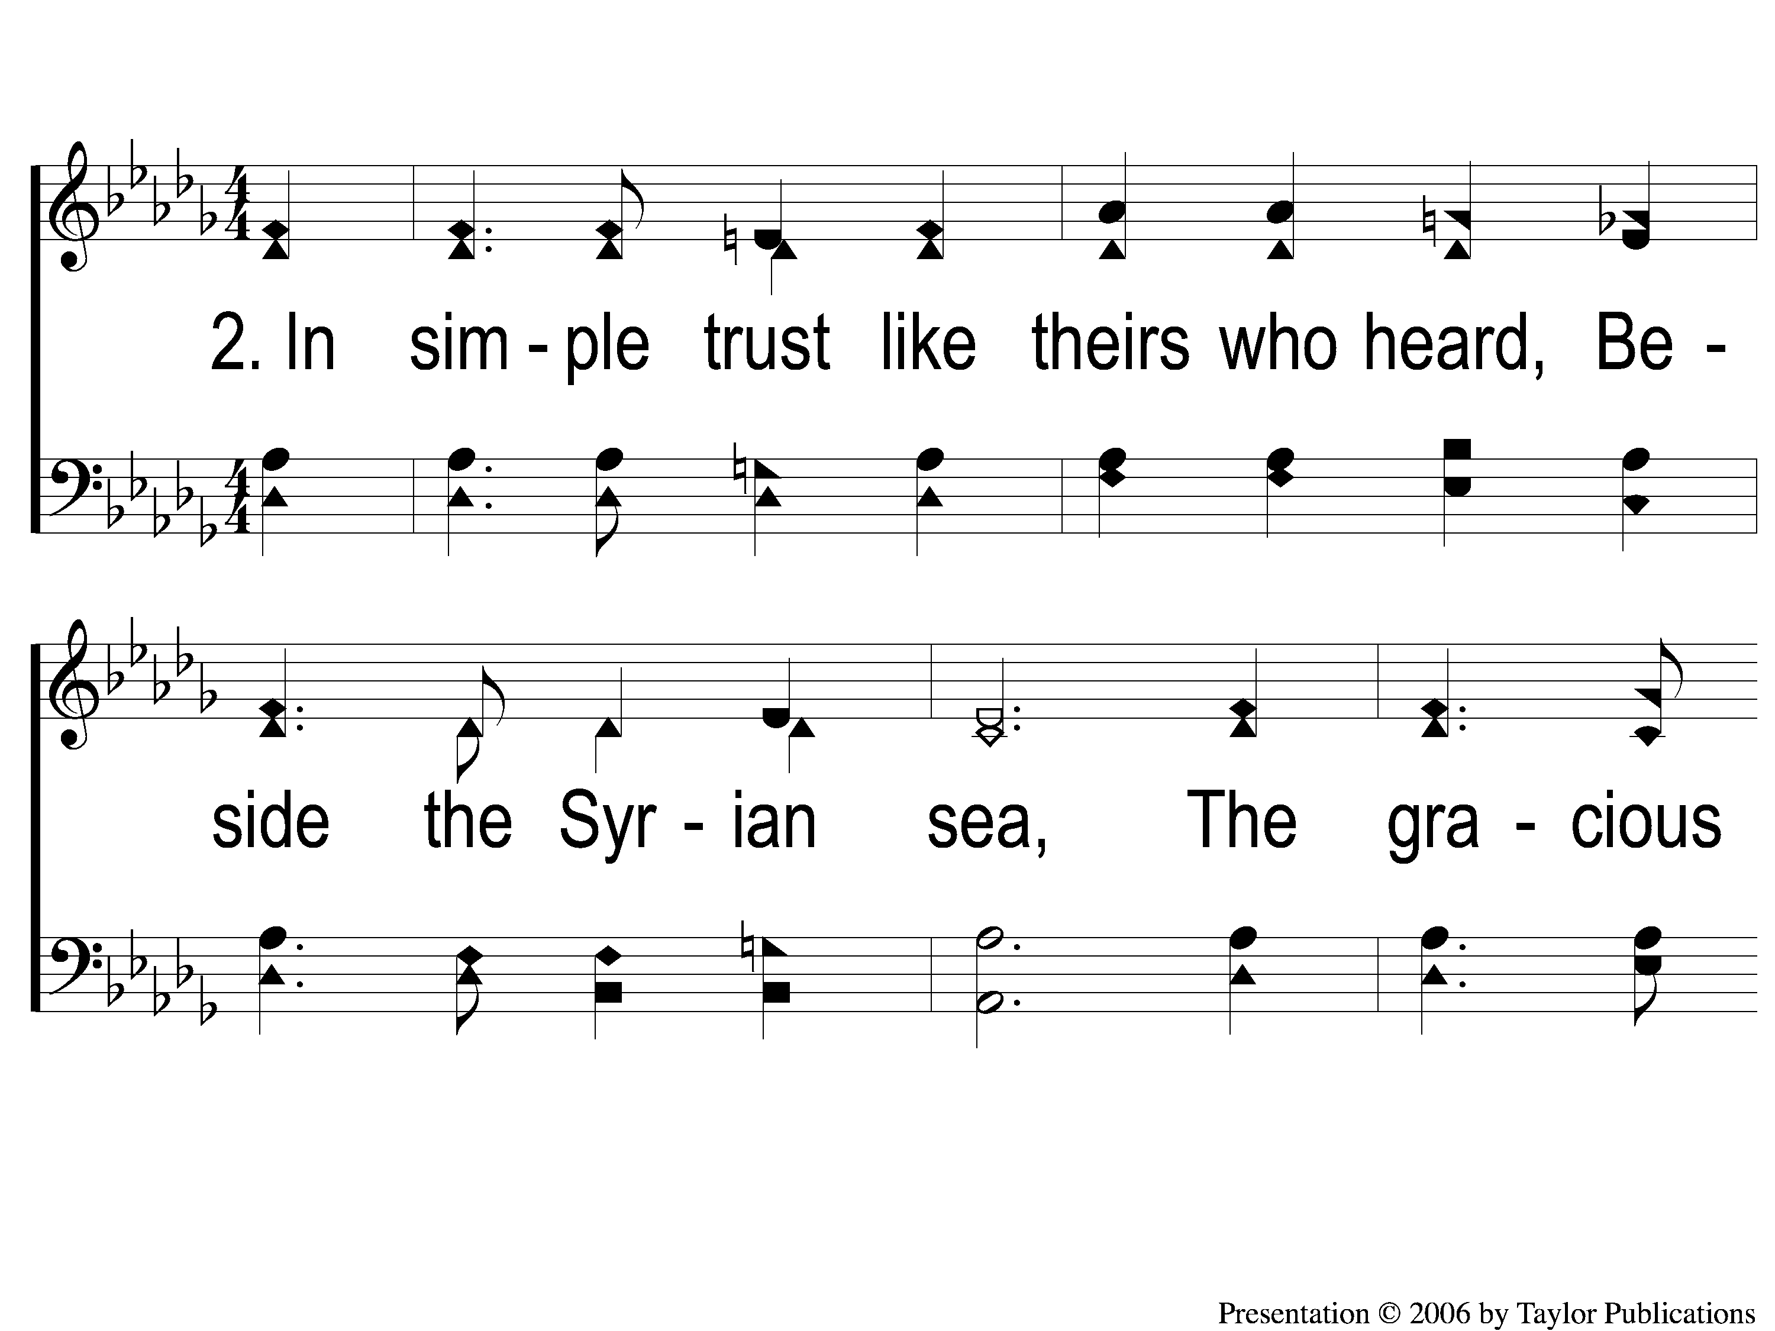
2-1 Dear Lord and Father of Mankind
Dear Lord and Father of Mankind
77

Slide 4
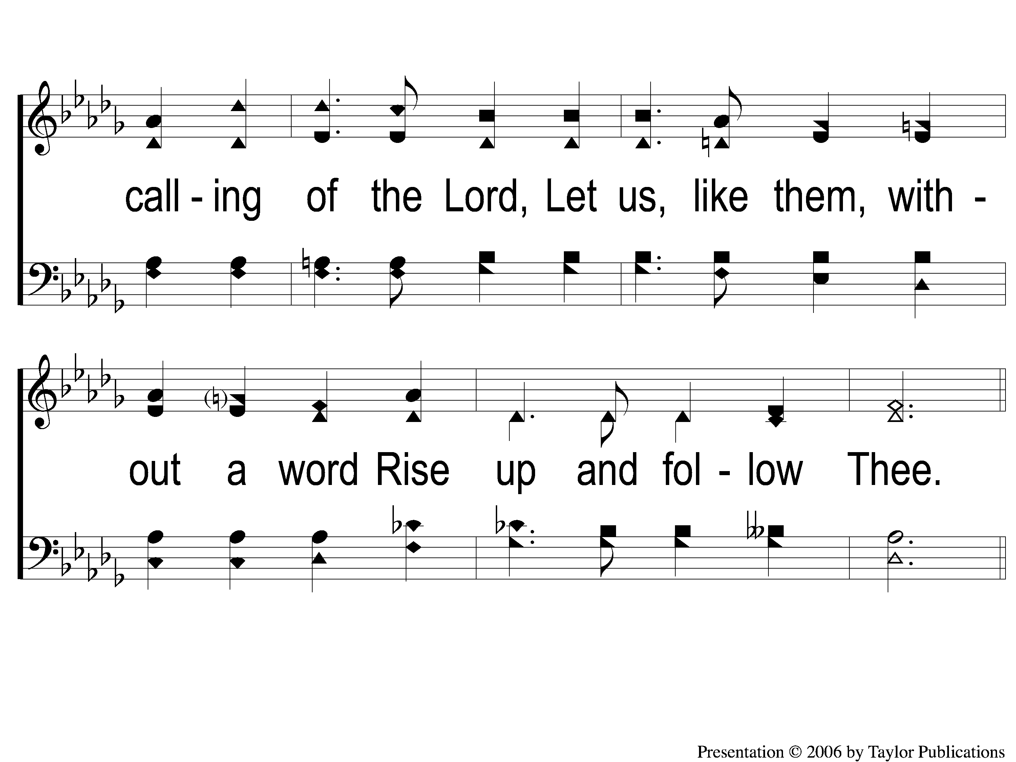
2-2 Dear Lord and Father of Mankind
Dear Lord and Father of Mankind
77

Slide 5
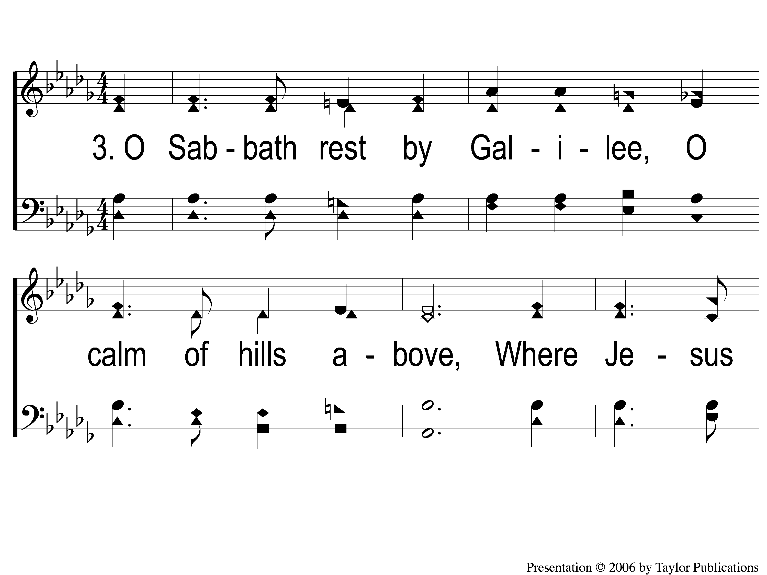
3-1 Dear Lord and Father of Mankind
Dear Lord and Father of Mankind
77

Slide 6
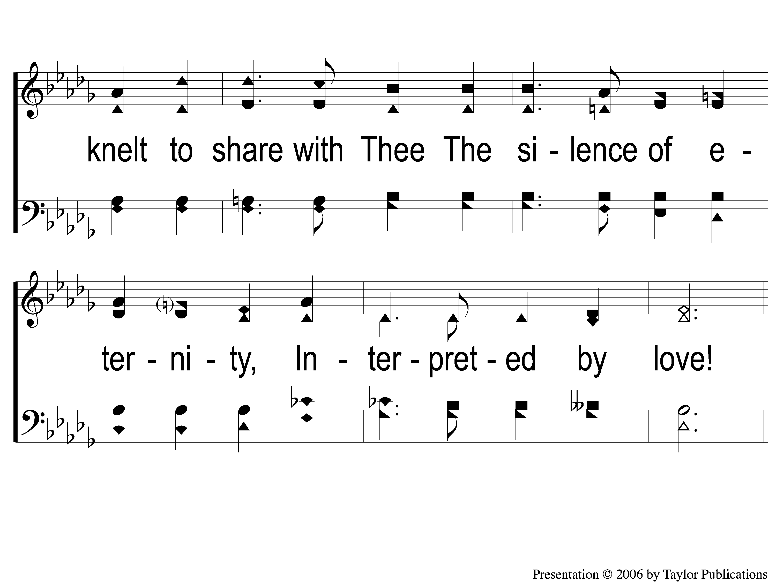
3-2 Dear Lord and Father of Mankind
Dear Lord and Father of Mankind
77

Slide 7
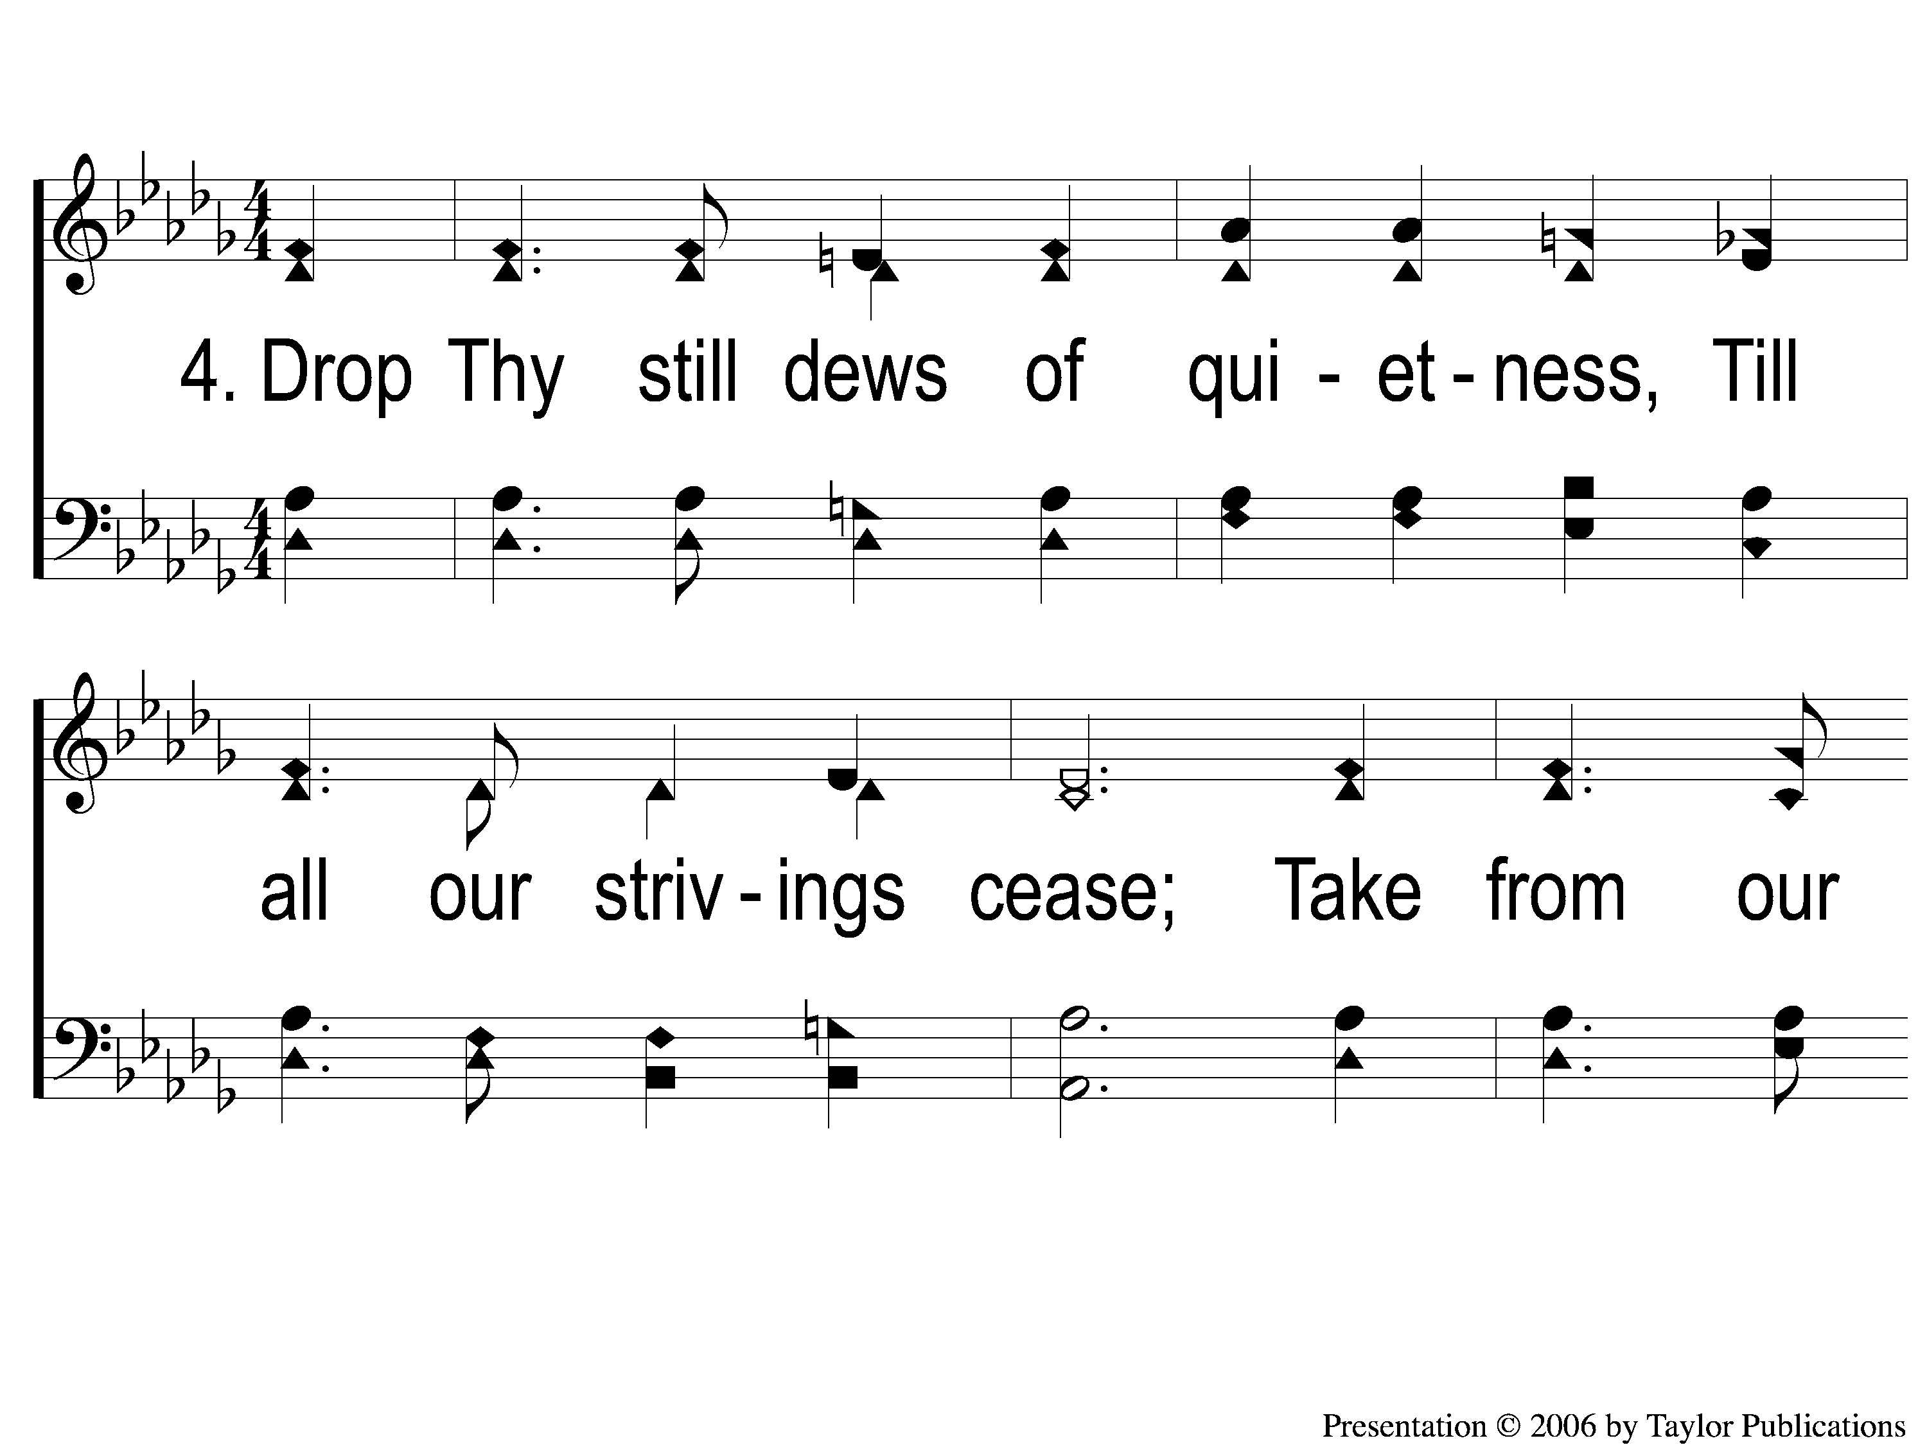
4-1 Dear Lord and Father of Mankind
Dear Lord and Father of Mankind
77

Slide 8
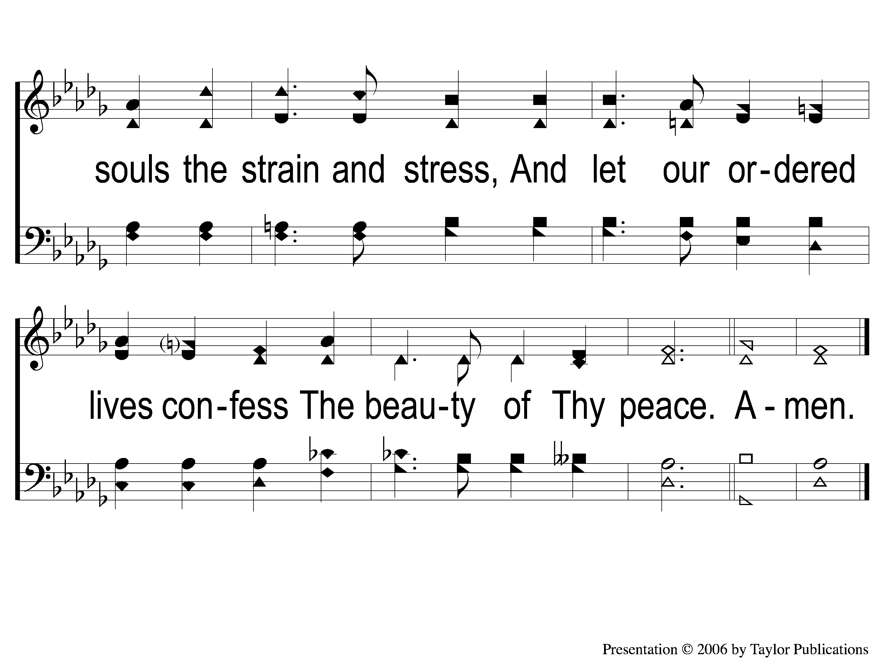
4-2 Dear Lord and Father of Mankind
Dear Lord and Father of Mankind
77

